Slide 1

FIT BUDDY BUSINESS PLAN
Bajaj Sasha Kim Sihyun Lui Kai Hong Saha Sapnojit Shifte Muhtasim Istiaq

Slide 2
01
02
Table of Cotents
03
04
PROBLEM ANALYSIS
BUSINESS OVERVIEW
Fitness Trend and Challenge in Hong Kong
Our App, Business Objective, and Target Audience
PROTOTYPE DEMONSTRATION
REVENUE STRATEGY
Core Features, i.e. searching for a PT
Transaction Fee and App Advertising

Slide 3
01
PROBLEM ANALYSIS
Fitness Trend and Challenge in Hong Kong

Slide 4
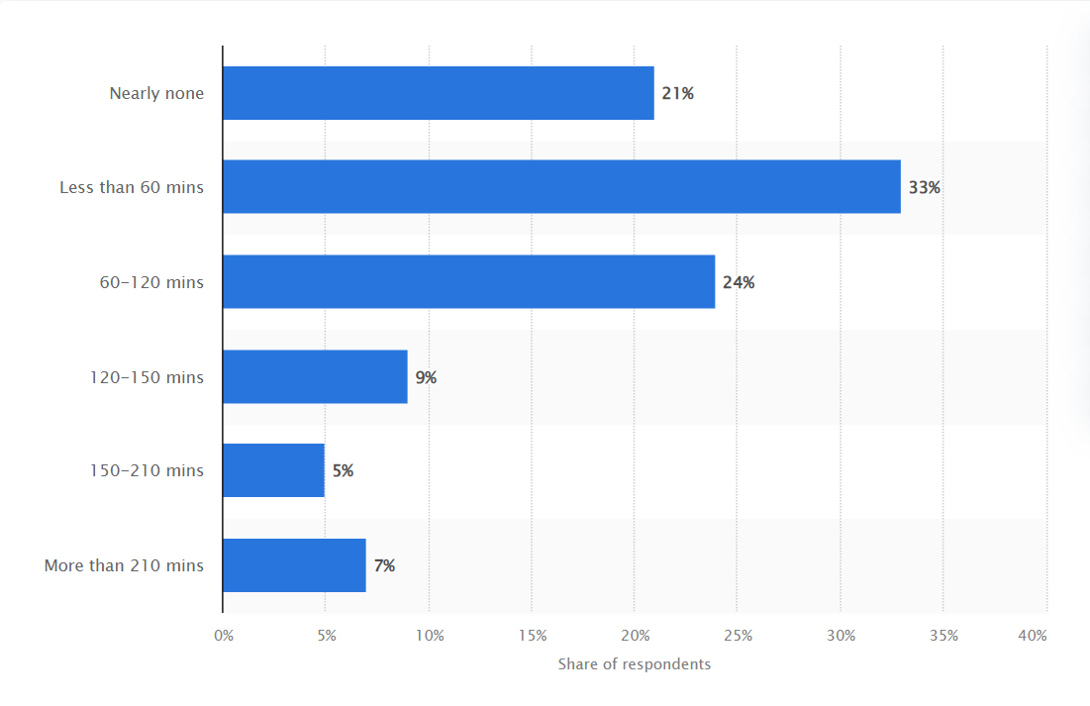
Insufficient Regular Physical Activities
Average duration per week used for physical activity
during COVID-19 pandemic among residents in Hong Kong
According to a survey conducted among Hong Kong residents in 2020, over 50 percent of respondents said to do physical exercises for less than about 60 minutes per week on average during the COVID-19 epidemic.
Problem Analysis
Reference: Statista
Notes:
https://www.statista.com/statistics/1256192/hong-kong-average-physical-exercise-duration-per-week-during-coronavirus-covid-19/
https://www.chp.gov.hk/en/healthtopics/content/25/8804.html#:~:text=Situation%20in%20Hong%20Kong,females%20and%2022.8%25%20for%20males.

Slide 5
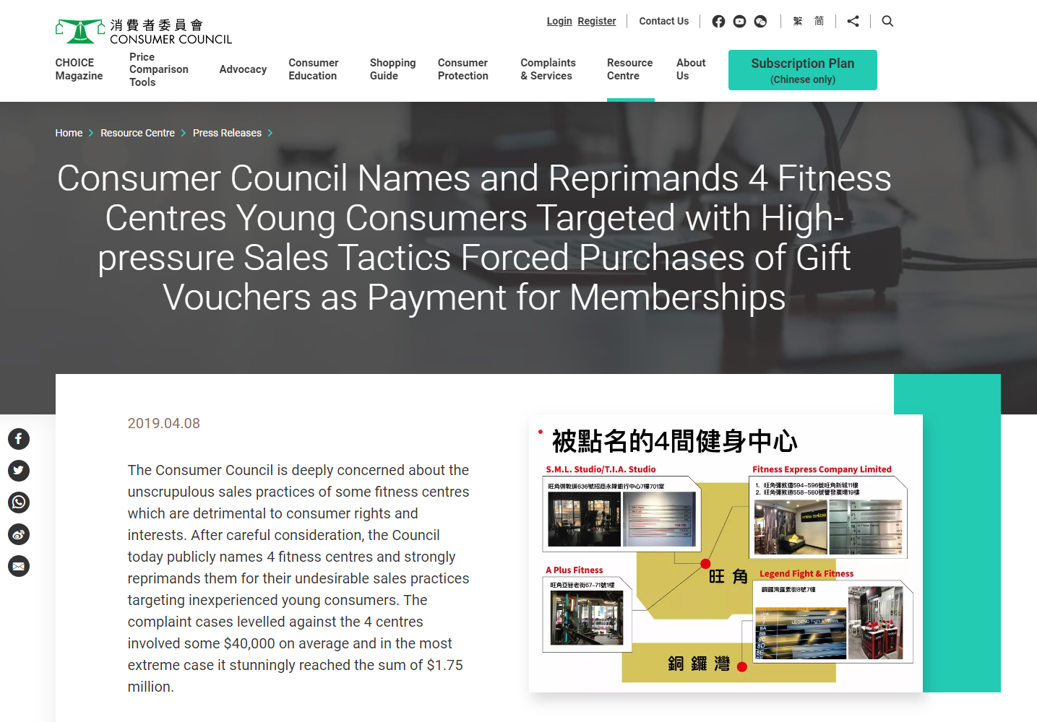
Lack of Information and Scam in the Fitness Industry
There is not enough relevant and easily accessible information available on the internet.
The Consumer Council is deeply concerned about the unscrupulous sales practices of some fitness centres
Problem Analysis
Reference: The Consumer Council
Notes:
https://www.scmp.com/news/hong-kong/law-and-crime/article/3119612/former-hong-kong-fitness-trainer-arrested-over-duping
https://www.consumer.org.hk/en/press-release/fitnesscentre

Slide 6
02
BUSINESS OVERVIEW
Our App, Business Objective, and Target Audience

Slide 7

Our App
Fit Buddy
This app offers a platform for individuals who are interested in working out to connect with a variety of available personal trainers
Business Overview

Slide 8

Business Overview
Business Objective
To promote fitness culture in Hong Kong
WHAT
To allow individuals to enjoy affordable personal training sessions in ease
HOW

Slide 9

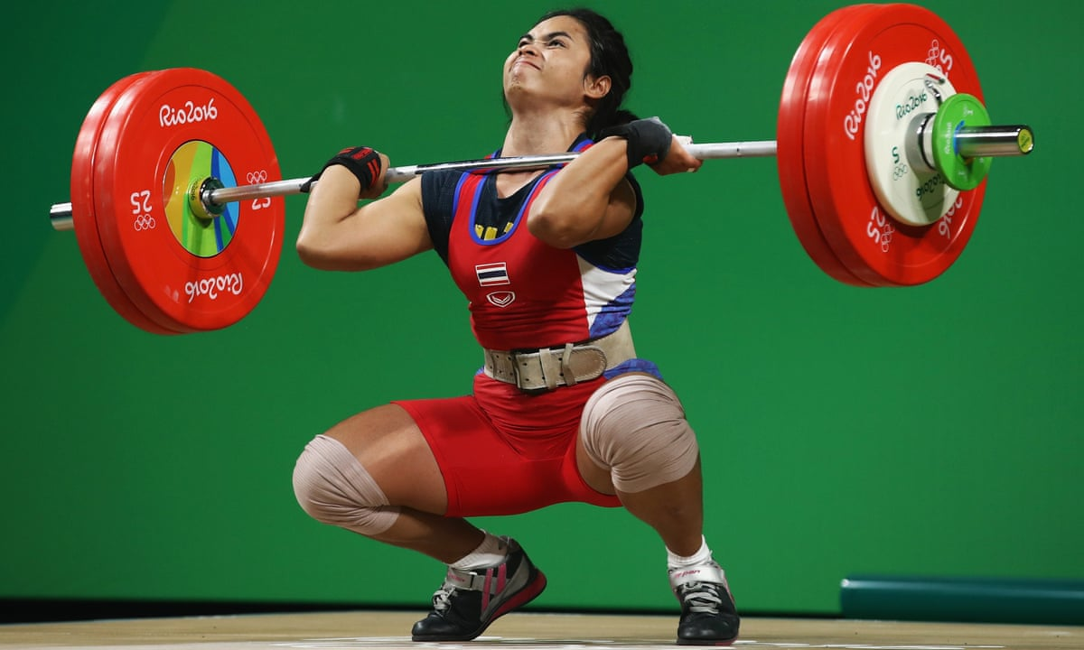

Target Audience / Segmentation
Service Provider --- Freelanced / Certified Personal Trainer
Customer --- Individual above 18 who is interested in working out or looking for
personal training classes in Hong Kong
Business Overview
 | Demographic Above 18
Geographic Hong Kong |  | Psychological Interested in Sports

Slide 10
03
PROTOTYPE DEMOSTRATION
Core Features, i.e. Searching for a PT
Notes:
https://marvelapp.com/prototype/bf34h31/screen/91216003

Slide 11
04
REVENUE STRATEGY
Transaction fee and App Advertising

Slide 12
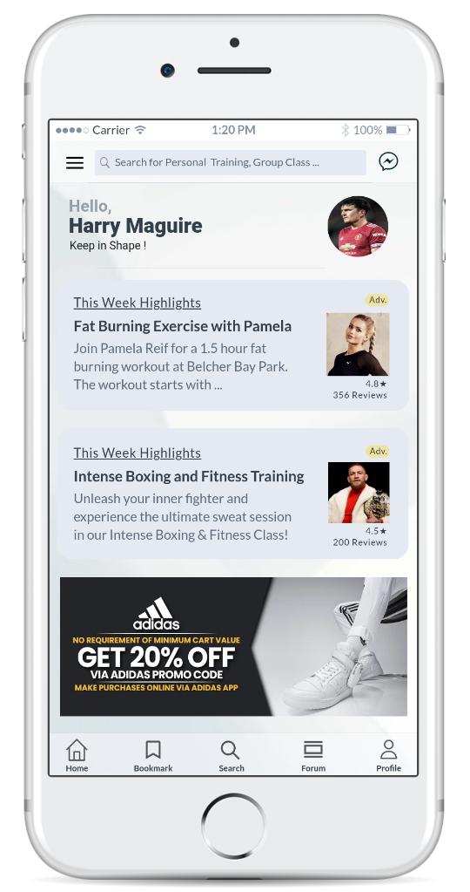
Revenue Strategy
Revenue Strategy
Transaction / Commission Fee
Earn revenue through commissions or transaction fees on bookings, e.g. 5% of the booking subtotal
App Advertising
Personal trainers can pay for an advertising fee, e.g. a bump/spotlight to increase visibility
Offer advertising oppotunities to relevant brands and businesses, e.g. sportswear brand to reach our user base

Slide 13

THANK YOU!

